Slide 1
Data Structures
16. Binary Tree Implementation
16-Tree Implementation
1

Slide 2
Tree ADT
Data Type: Any type of objects can be stored in a tree
Accessor methods
root() – returns the root of the tree
parent(p) – returns the parent of a node
children(p) – returns the children of a node
Query methods
size() – returns the number of nodes in the tree
isEmpty() – returns true if the tree is empty
elements() – returns all elements
isRoot(p) – returns true if node p is the root
Other methods
Tree traversal, Node addition/deletion, create/destroy

Slide 3
Binary Tree Storage
Contiguous storage
Linked list based storage

Slide 4
Linked List Storage

Slide 5
As Linked List Structure (1)
We can implement a binary tree by using a struct which stores:
An element
A left child pointer (pointer to first child)
A right child pointer (pointer to second child)
struct Node{ Type value;
Node *LeftChild,*RightChild;
}*root;
The root pointer points to the root node
– Follow pointers to find every other element in the tree
Leaf nodes have LeftChild and RightChild pointers set to NULL

Slide 6



As Linked List Structure: Example
Root pointer
a
b
c
d
e
f
 | g
 | h
i
j
k
l

Slide 7
Tree Traversal

Slide 8
Tree Traversal
To traverse (or walk) the tree is to visit each node in the tree exactly once
Traversal must start at the root node
There is a pointer to the root node of the binary tree
Two types of traversals
Breadth-First Traversal
Depth-First Traversal

Slide 9
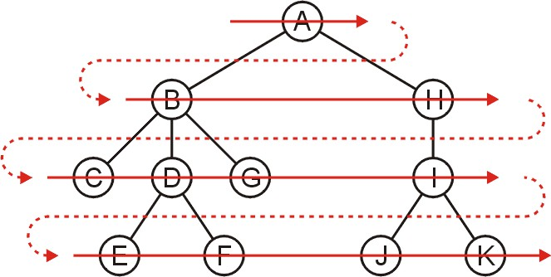
Breadth-First Traversal (For Arbitrary Trees)
All nodes at a given depth d are traversed before nodes at d+1
Can be implemented using a queue
Order: A B H C D G I E F J K

Slide 10
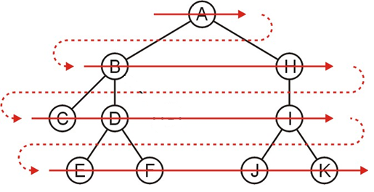
Breadth-First Traversal – Implementation
Create a queue and push the root node onto the queue
While the queue is not empty:
Enqueue all of its children of the front node onto the queue
Dequeue the front node
Order: A B H C D I E F J K

Slide 11
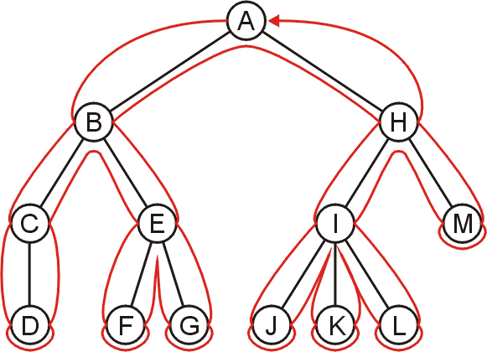
Depth-First Traversal (For Arbitrary Trees)
Traverse as much as possible along the branch of each child before going to the next sibling
Nodes along one branch of the tree are traversed before backtracking
Each node could be visited multiple times in such a scheme
The first time the node is approached (before any children)
The last time it is approached (after all children)

Slide 12
Depth-First Tree Traversal (Binary Trees)
For each node in a binary tree, there are three choices
Visit the node first
Visit the node after left subtree
Visit the node after both the subtrees
These choices lead to three commonly used traversals
Preorder traversal: visit Root (Left subtree) (Right subtree)
Inorder traversal: (Left subtree) visit Root (Right subtree)
Postorder traversal: (Left subtree) (Right subtree) visit Root

Slide 13
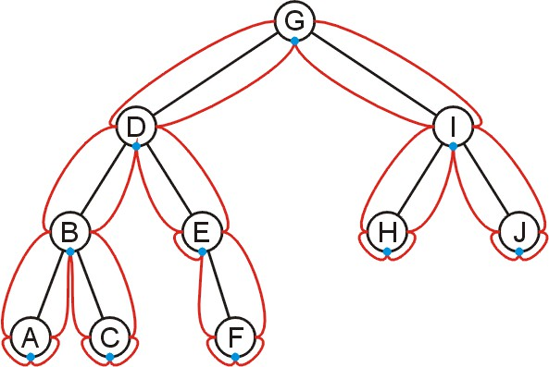
Inorder Traversal
Algorithm
Traverse the left subtree in inorder
Visit the root
Traverse the right subtree in inorder
A, B, C, D, E, F, G, H, I, J

Slide 14
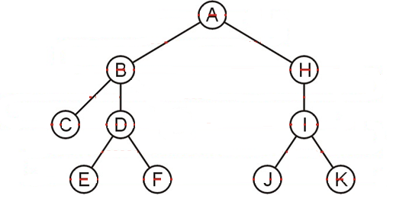
Inorder Traversal
Algorithm
Traverse the left subtree in inorder
Visit the root
Traverse the right subtree in inorder
Order: ????

Slide 15
Inorder Traversal
Algorithm
Traverse the left subtree in inorder
Visit the root
Traverse the right subtree in inorder
+
*
+
Example
Left + Right
[Left * Right] + [Left + Right]
(A * B) + [(Left * Right) + E)
(A * B) + [(C * D) + E]
A
B *
E
C
D

Slide 16
Inorder Traversal – Implementation
-Take hint from the following code…
-Will we have 1 base case and 1 recursive case as below?
void printReverse(Node* current)
{
if (current == nullptr)
return;
printReverse(current->next);
cout << current->data << " ";
}
void print(Node* current)
{
if (current == nullptr)
return;
cout << current->data << " ";
print(current->next);
}

Slide 17
Inorder Traversal – Implementation
void inorder(Node *p) const
{
if (p != NULL)
{
inorder(p->leftChild); cout << p->info << " "; inorder(p->rightChild);
}
}
void main () {
. . .
inorder (root);
}

Slide 18
Preorder Traversal
Algorithm
Visit the node
Traverse the left subtree
Traverse the right subtree
+
*
+
Example
– + Left Right
– + [ * Left Right] [+ Left Right]
– + ( * AB) [+ * Left Right E]
– +*AB + *C D E
A
B *
E
C
D

Slide 19
Preorder Traversal – Implementation
void preorder(Node *p) const
{
if (p != NULL)
{
cout << p->info << " "; preorder(p->leftChild); preorder(p->rightChild);
}
}
void main () {
. . .
preorder (root);
}

Slide 20
Postorder Traversal
Algorithm
Traverse the left subtree
Traverse the right subtree
Visit the node
+
*
+
Example
Left Right +
[Left Right *] [Left Right+] +
(AB*) [Left Right * E + ]+
(AB*) [C D * E + ]+
AB* C D * E + +
A
B *
E
C
D

Slide 21
Postorder Traversal – Implementation
void postorder(Node *p) const
{
if (p != NULL)
{
postorder(p->leftChild); postorder(p->rightChild); cout << p->info << " ";
}
}
void main () {
. . .
postorder (root);
}

Slide 22
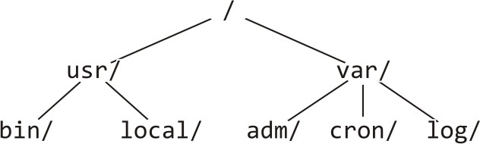
Example: Printing a Directory Hierarchy
Consider the directory structure presented on the left
– Which traversal should be used?
/
usr/
bin/ local/
var/
adm/ cron/ log/

Slide 23
Expression Tree

Slide 24

Expression Tree
Each algebraic expression has an inherent tree-like structure
An expression tree is a binary tree in which
The parentheses in the expression do not appear
Tree representation captures the intent of parenthesis
The leaves are the variables or constants in the expression
The non-leaf nodes are the operators in the expression
Binary operator has two non-empty subtrees
+
Unary operator has one non-empty subtree
3
-
*
+
4
5 9
6

Slide 25
Convert Postfix into Expression Tree – Algorithm
while(not the end of the expression)
{
if(the next symbol in the expression is an operand)
{
create a node for the operand ;
push the reference to the created node onto the stack ;
7 }
if(the next symbol in the expression is a binary operator)
{
create a node for the operator ;
pop from the stack a reference to an operand ;
make the operand the right subtree of the operator node ;
pop from the stack a reference to an operand ;
make the operand the left subtree of the operator node ;
push the reference to the operator node onto the stack ;
16 }
17 }

Slide 26
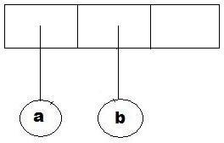
Convert Postfix into Expression Tree – Example (1)
while(not the end of the expression)
{
if(the next symbol is an operand)
{
create a node for the operand ;
push the reference to the created node onto the stack;
}
Example:
a b + c d e + * *
if(the next symbol is a binary operator)
{
create an operator node;
pop operand from the stack;
make the operand the right subtree ;
pop operand from the stack;
make the operand the left subtree ;
push the operator node onto the stack;
}
}

Slide 27
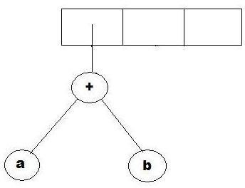
Convert Postfix into Expression Tree – Example (2)
while(not the end of the expression)
{
if(the next symbol is an operand)
{
create a node for the operand ;
push the reference to the created node onto the stack ;
}
Example:
a b + c d e + * *
if(the next symbol is a binary operator)
{
create an operator node;
pop operand from the stack;
make the operand the right subtree ;
pop operand from the stack;
make the operand the left subtree ;
push the operator node onto the stack;
}
}

Slide 28
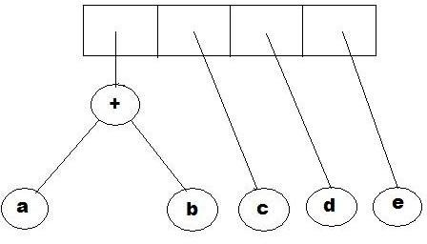
Convert Postfix into Expression Tree – Example (3)
while(not the end of the expression)
{
if(the next symbol is an operand)
{
create a node for the operand ;
push the reference to the created node onto the stack;
}
Example:
a b + c d e + * *
if(the next symbol is a binary operator)
{
create an operator node;
pop operand from the stack;
make the operand the right subtree ;
pop operand from the stack;
make the operand the left subtree ;
push the operator node onto the stack;
}
}

Slide 29
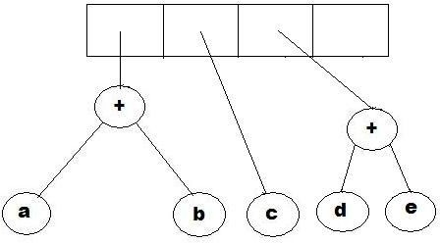
Convert Postfix into Expression Tree – Example (4)
while(not the end of the expression)
{
if(the next symbol is an operand)
{
create a node for the operand ;
push the reference to the created node onto the stack ;
}
Example:
a b + c d e + * *
if(the next symbol is a binary operator)
{
create an operator node;
pop operand from the stack;
make the operand the right subtree ;
pop operand from the stack;
make the operand the left subtree ;
push the operator node onto the stack;
}
}

Slide 30
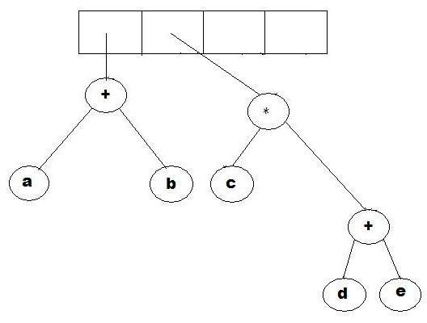
Convert Postfix into Expression Tree – Example (5)
while(not the end of the expression)
{
if(the next symbol is an operand)
{
create a node for the operand ;
push the reference to the created node onto the stack ;
}
Example:
a b + c d e + * *
if(the next symbol is a binary operator)
{
create an operator node;
pop operand from the stack;
make the operand the right subtree ;
pop operand from the stack;
make the operand the left subtree ;
push the operator node onto the stack;
}
}

Slide 31
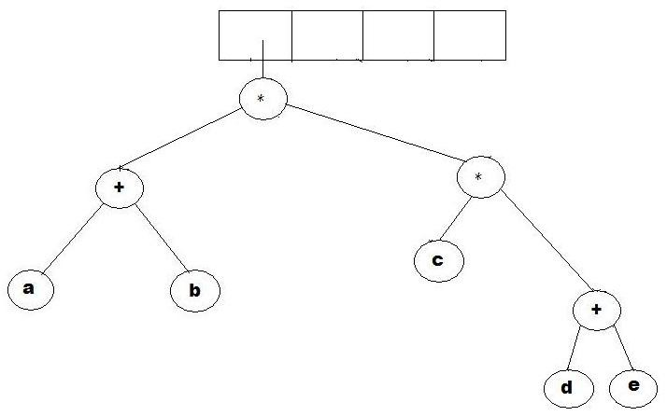
Convert Postfix into Expression Tree – Example (6)
while(not the end of the expression)
{
if(the next symbol is an operand)
{
create a node for the operand ;
push the reference to the created node onto the stack ;
}
Example:
a b + c d e + * *
if(the next symbol is a binary operator)
{
create an operator node;
pop operand from the stack;
make the operand the right subtree ;
pop operand from the stack;
make the operand the left subtree ;
push the operator node onto the stack;
}
}

Slide 32
Why Expression Tree?
Expression trees impose a hierarchy on the operations
Terms deeper in the tree get evaluated first (nested expressions get solved first)
Establish correct precedence of operations without using parentheses (deeper the term-> higher the precedence -> gets evaluated first)
A compiler will read an expression in a language like C++/Java, and transform it into an expression tree
Expression trees can be very useful for:
Evaluation of the expression
Generating correct compiler code to actually compute the expression's value at execution time

Slide 33
Evaluating an Expression Tree
Perform a post-order traversal of the tree
Ask each node to evaluate itself
An operand node evaluates itself by just returning its value
An operator node has to apply the operator
To the results of evaluations from its left subtree and right subtree
+
3 1 2
(2 + ((5 – 1) * 3))
Order of evaluation:
2
*
-
3
5
1

Slide 34
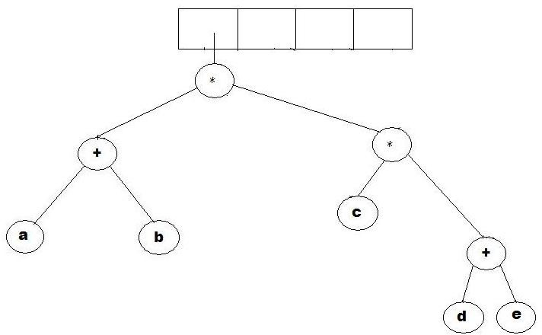
Evaluating an Expression Tree – Example
Expression:
a b + c d e + * * 1 2 + 3 4 5 + * *

Slide 35
Evaluating an Expression Tree - Implementation
evaluate(ExpressionTree t){
if(t is a leaf)
return value of t's operand ;
else{
operator = t.element ;
operand1 = evaluate(t.left) ;
operand2 = evaluate(t.right) ;
return(applyOperator(operand1, operator, operand2) ; 9
}
10 }

Slide 36

Any Question So Far?

